Slide 1
An Analysis on Meteors and their Light Curves
Solvay Blomquist
Mentor: Dr. Nick Moskovitz
Northern Arizona University Flagstaff, AZ
Lowell Observatory Flagstaff, AZ

Slide 2
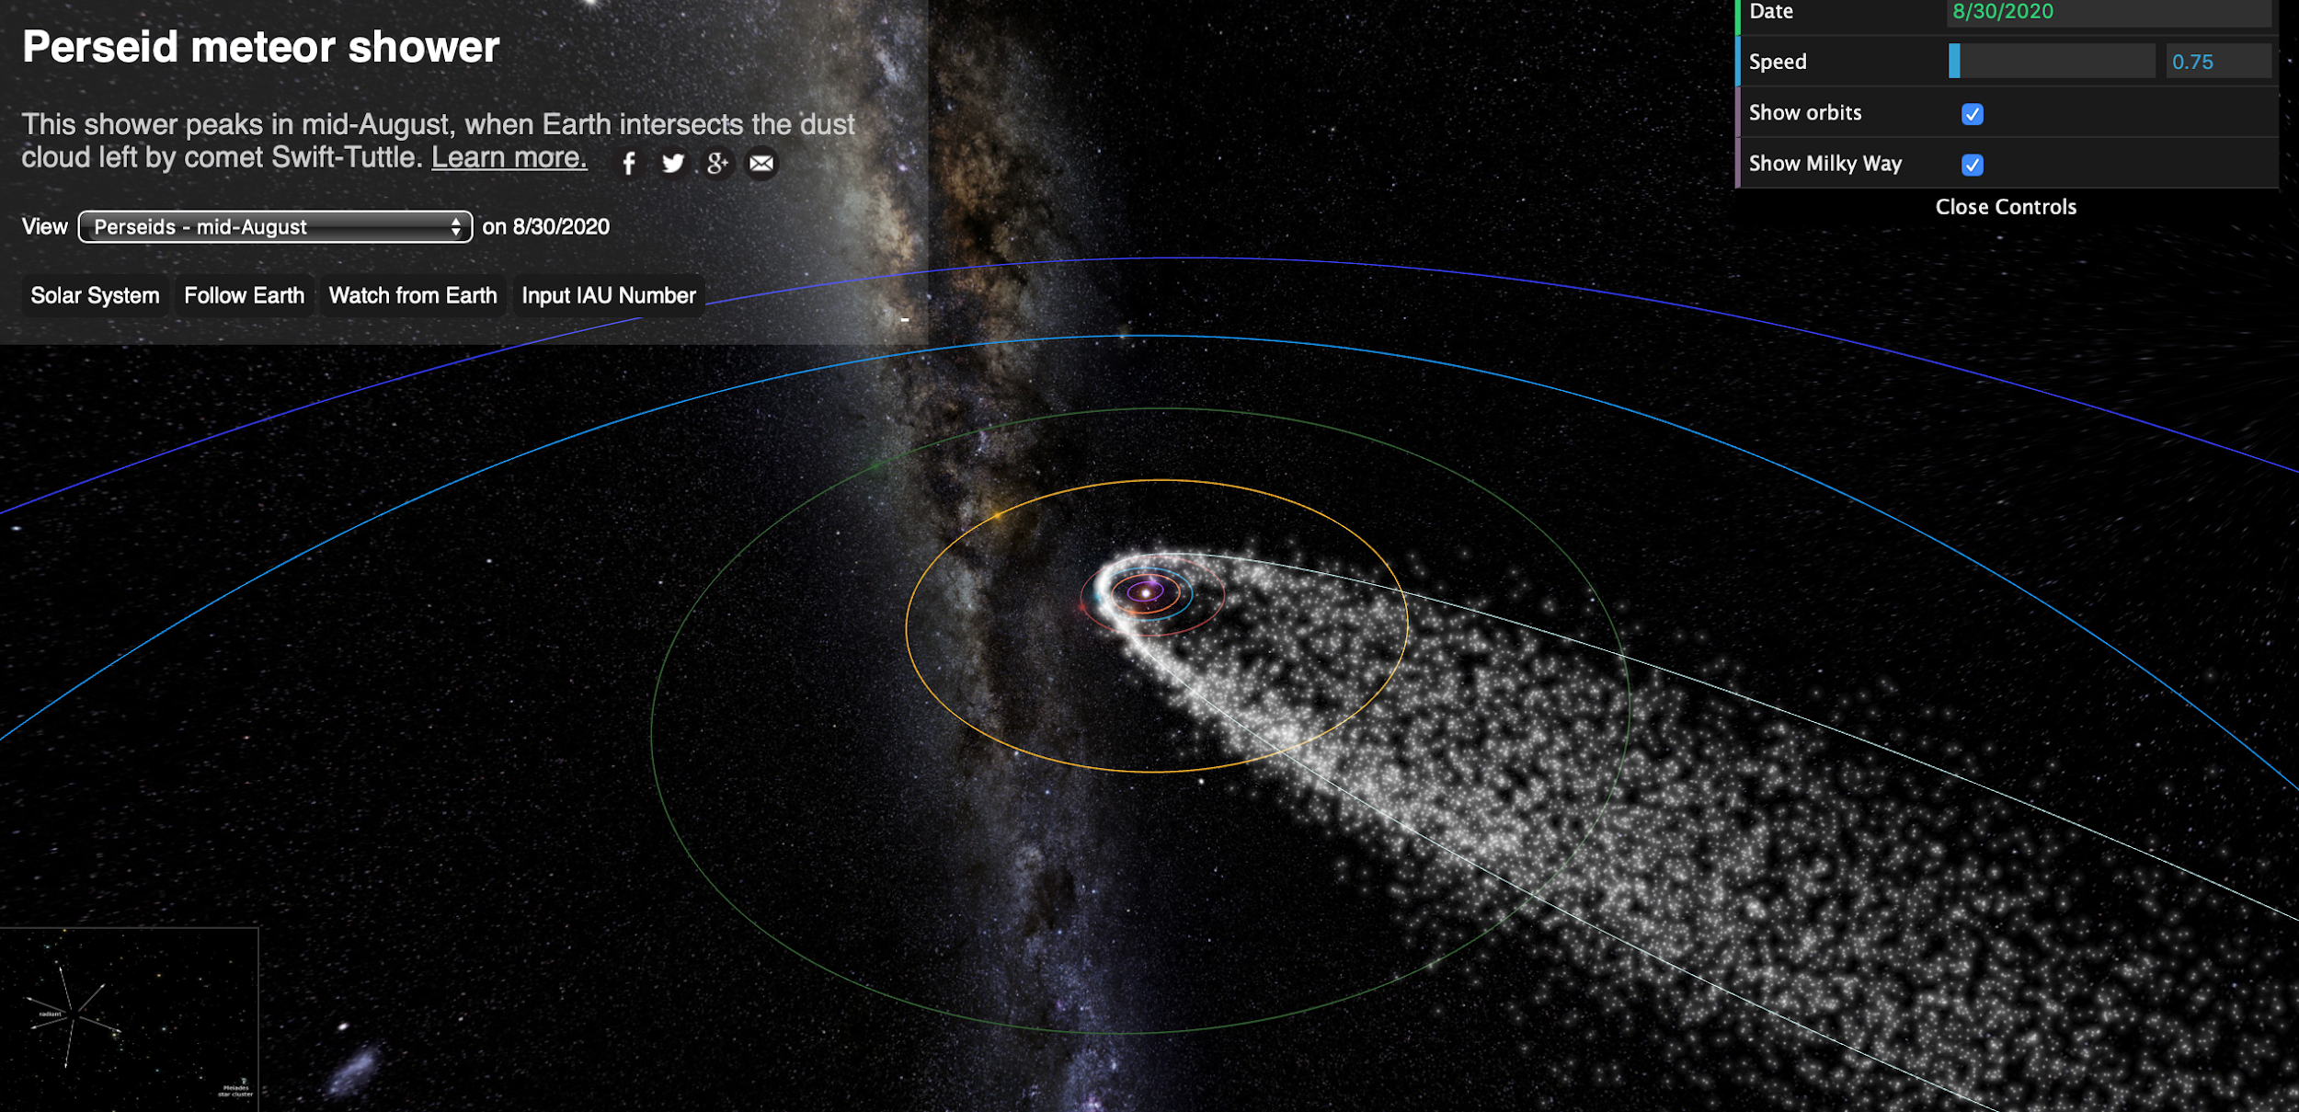
Meteor Science
A meteor is defined as a body of matter from space that enters Earth’s atmosphere.
Meteors are able to provide insight to the history of our Solar System.
Two populations of meteors based on origin referred to as shower meteors and sporadic meteors:
  Origin of shower meteors are comets.
  Origin of sporadic meteors are asteroids.
Source: https://www.meteorshowers.org
Notes:
Talk about two populations of meteors and what conclusions you’re looking to make.

Slide 3
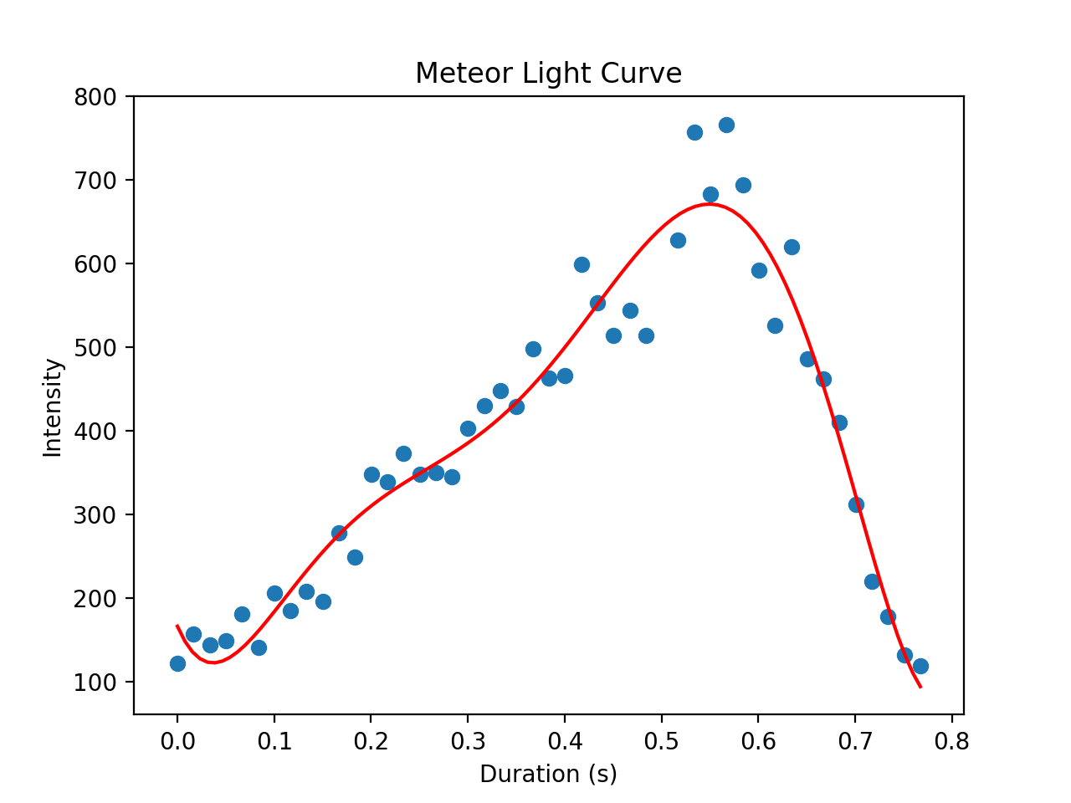
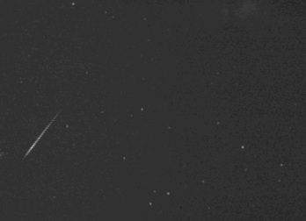
Light Curves
Meteors produce a light curve (time vs. intensity) when detected entering Earth’s atmosphere.
Notes:
Meteor detected on 3/24

Slide 4
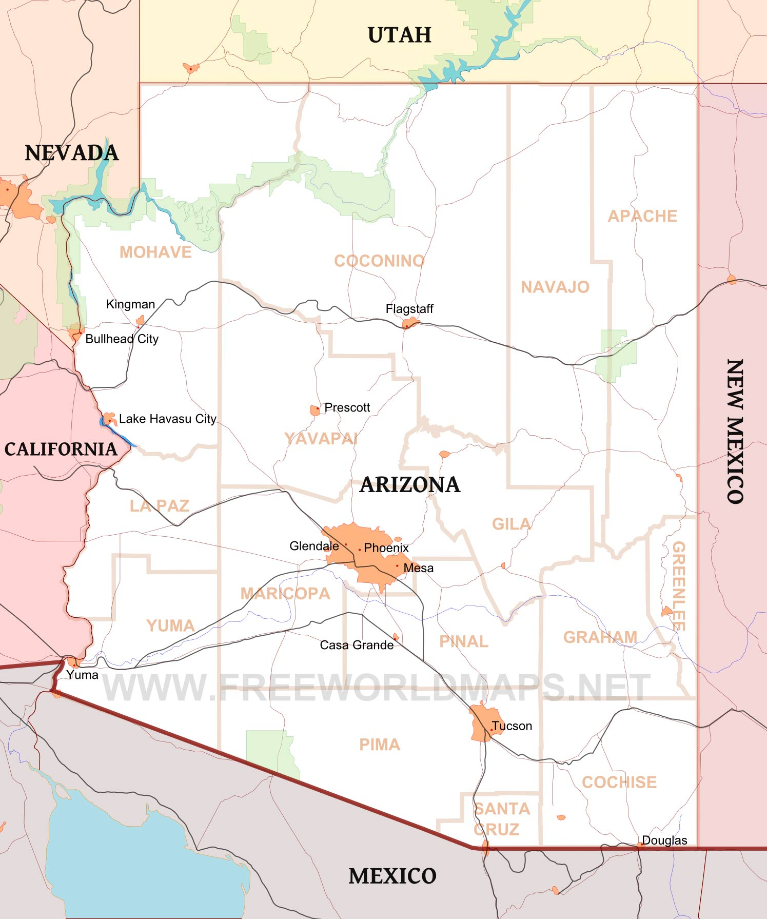
LOCAMS
Stands for “Lowell Observatory Cameras for Allsky Meteor Surveillance”. A part of a larger project, CAMS, based out of SETI Institute.
Camera stations at Lowell Observatory, Discovery Channel Telescope, Embry Riddle and Meteor Crater in northern AZ.
Goal: autonomously detect meteors, triangulate a meteor’s position in the sky and track its trail from its source in the solar system to our atmosphere.

Slide 5
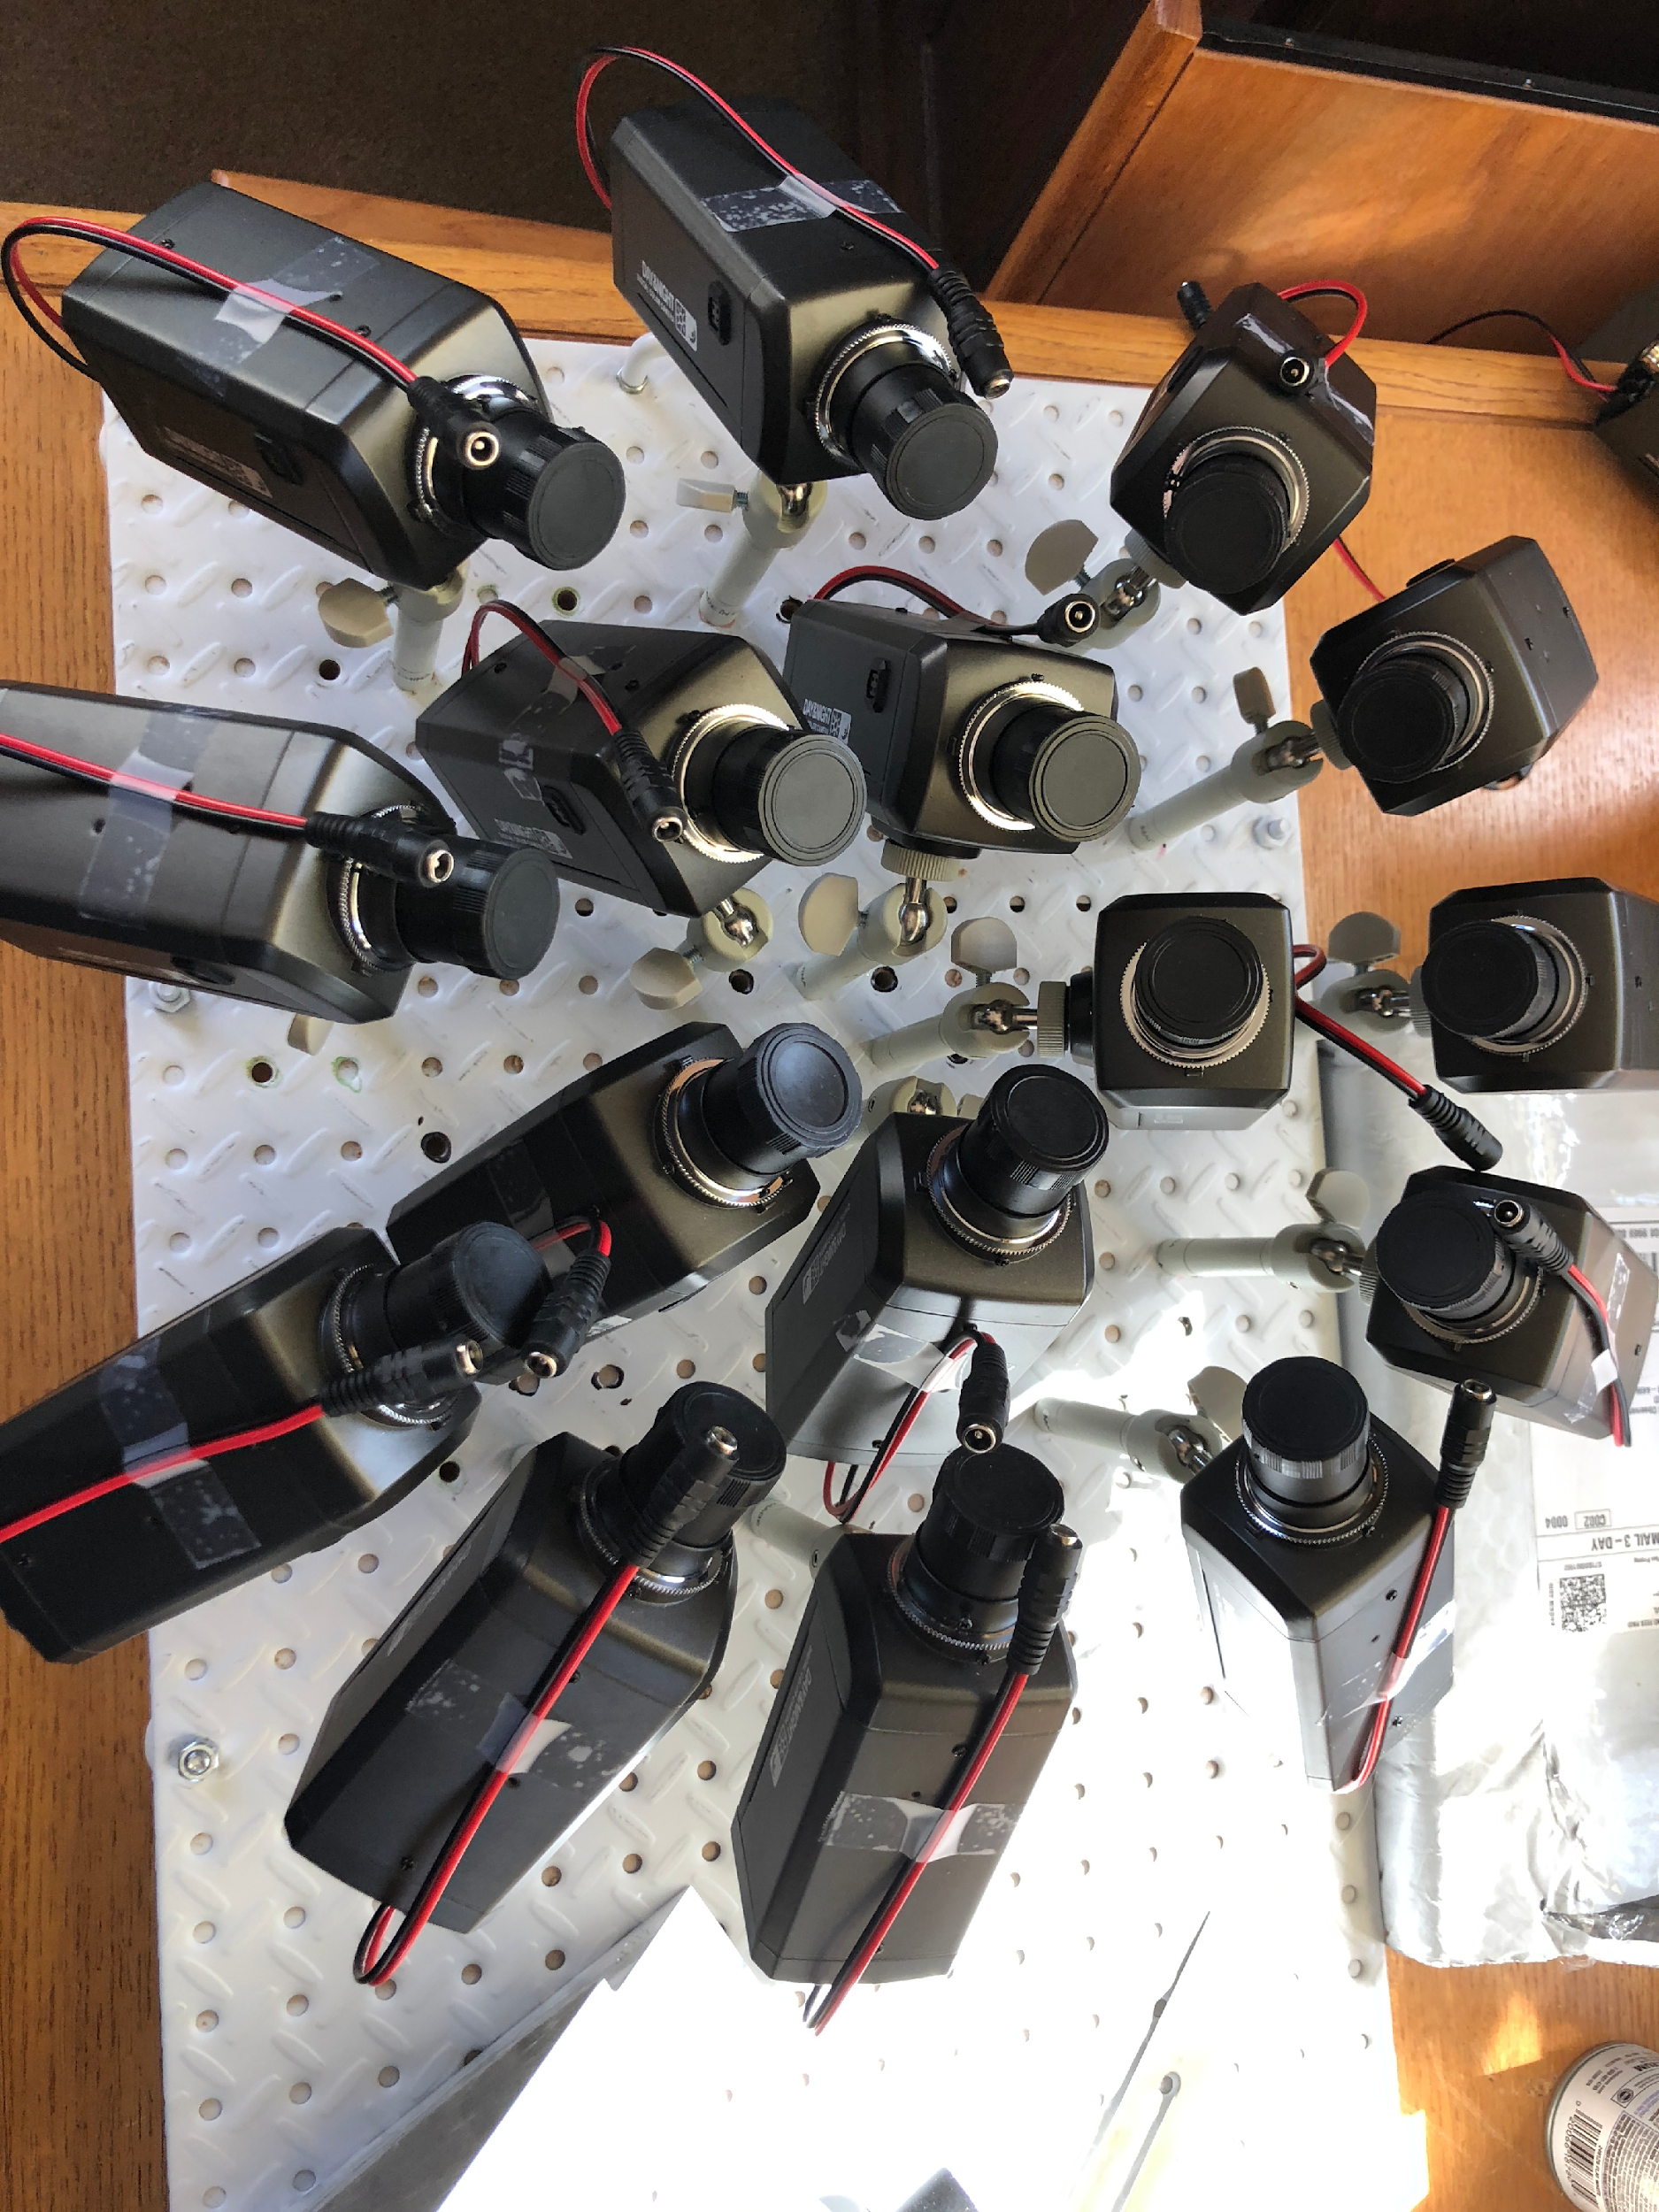
LOCAMS – Camera Stations
16 CCTV cameras placed into an aluminum box
Arranged in two rings, an outer and inner ring

Slide 6
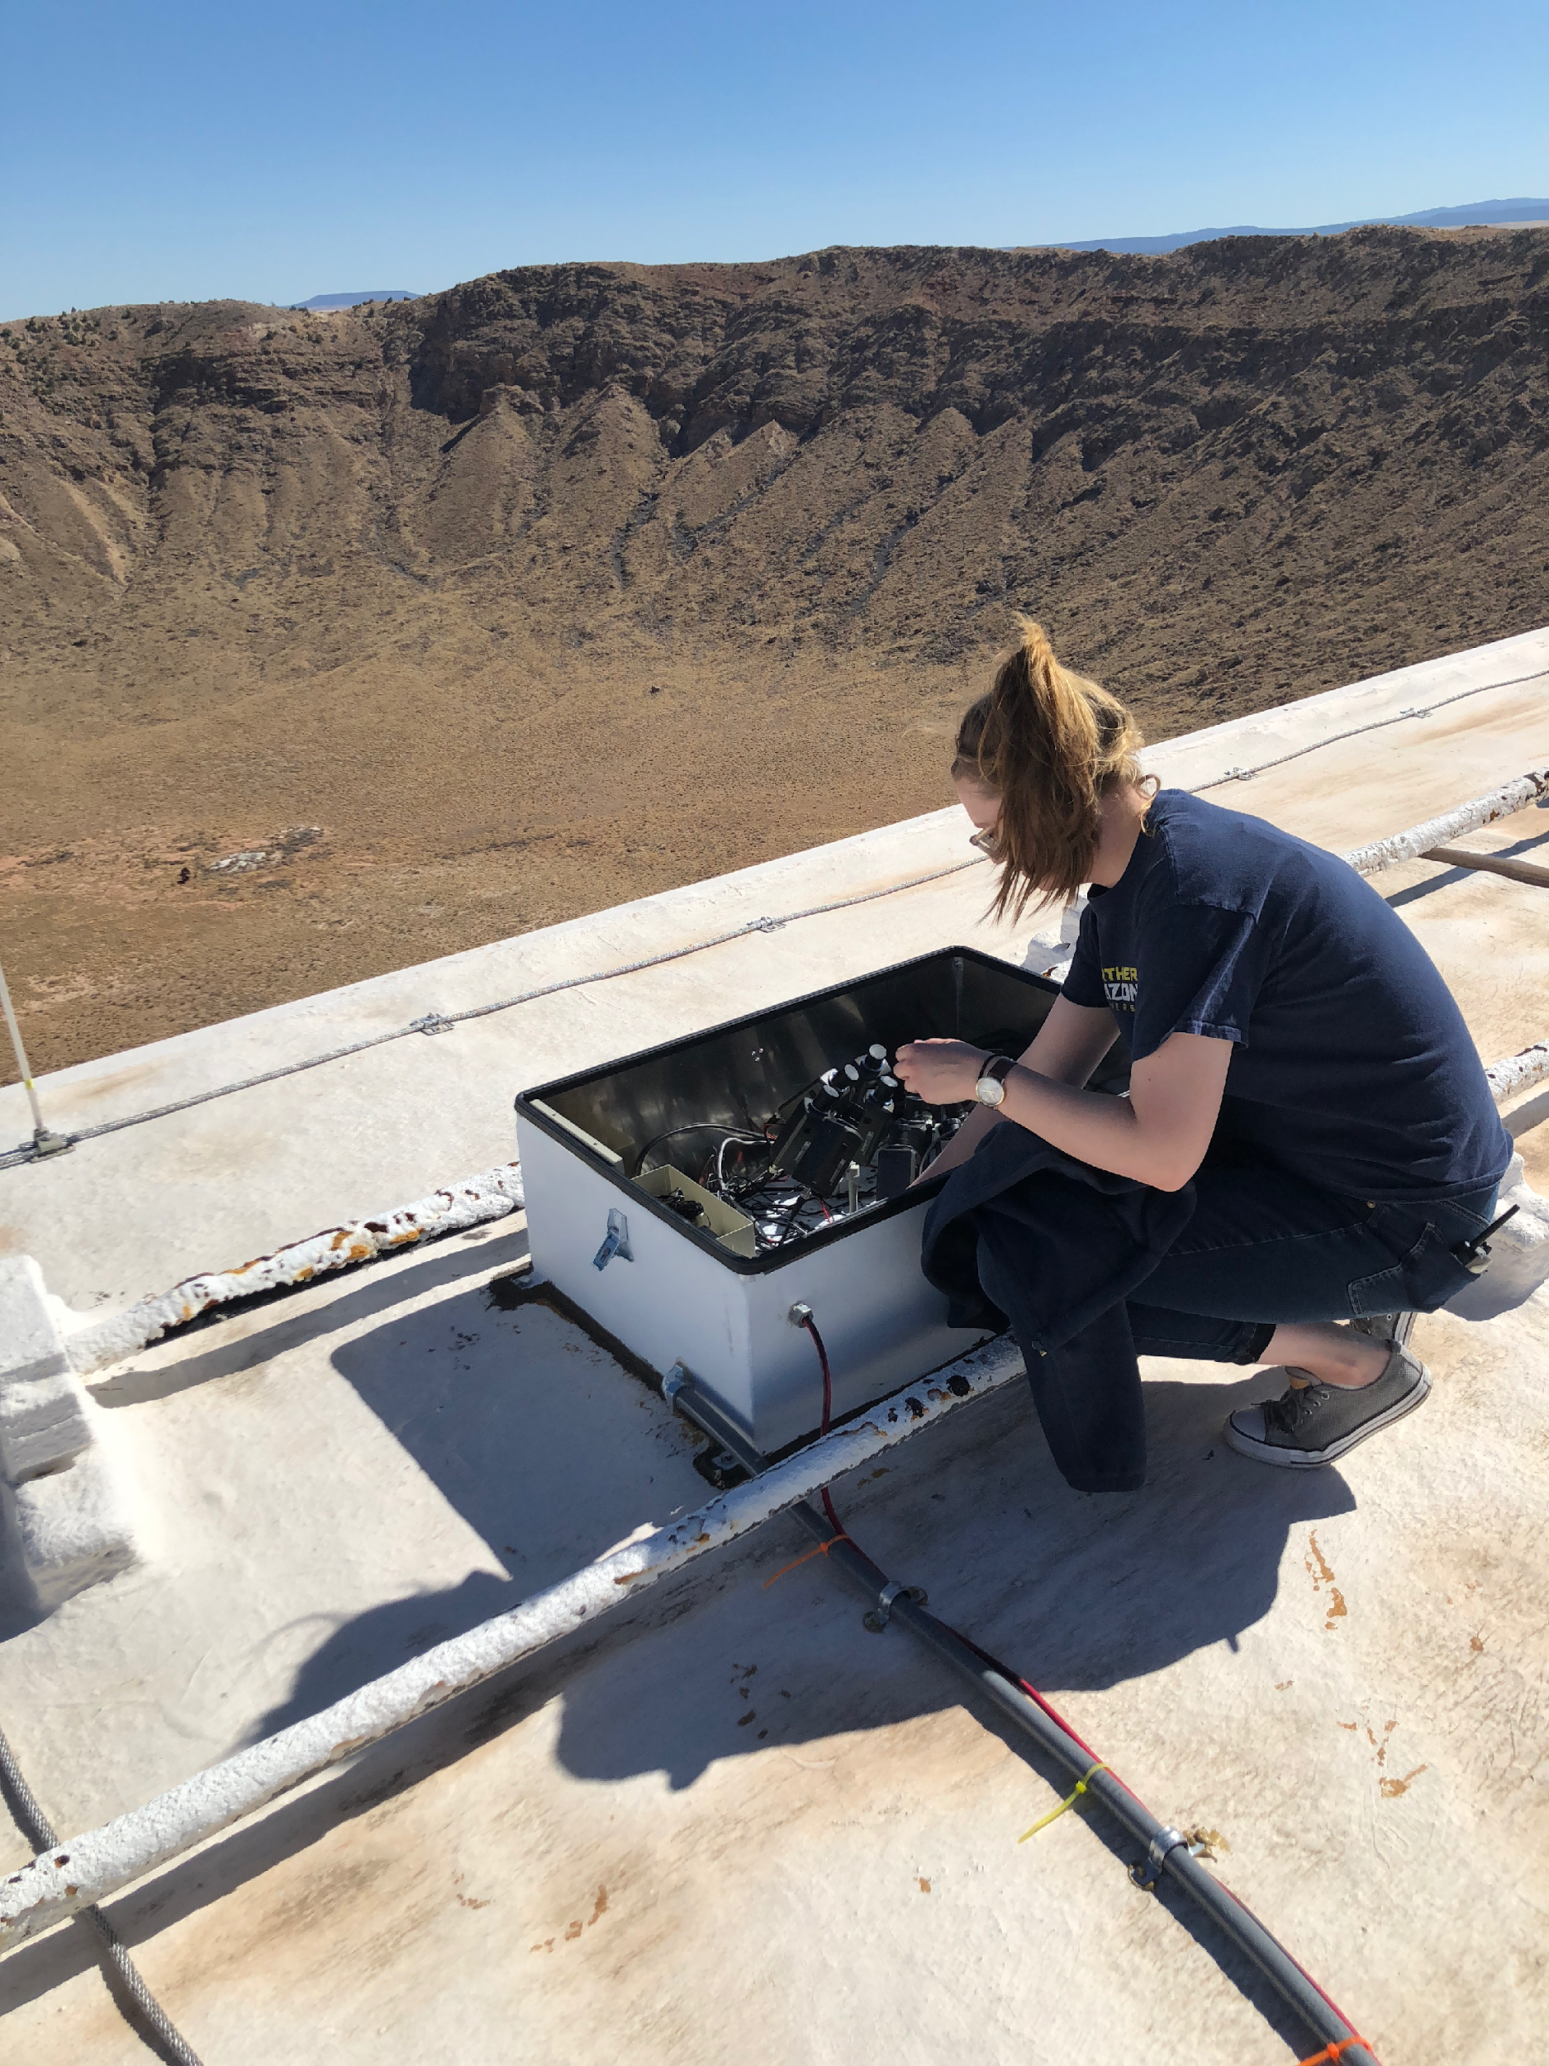
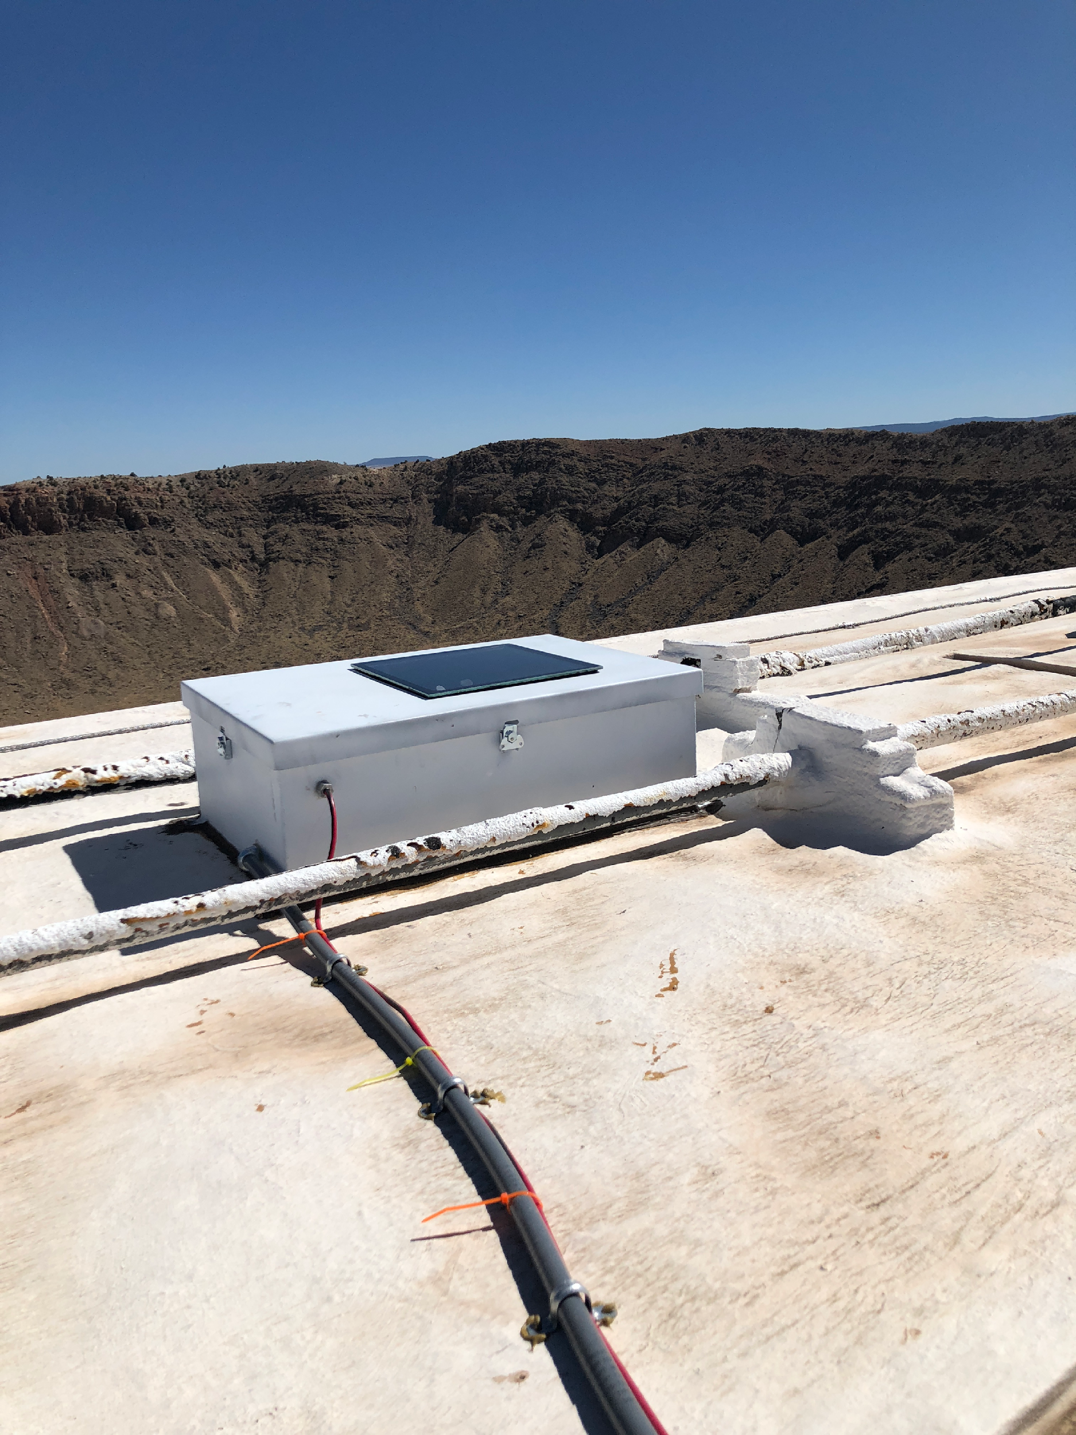

Slide 7
Data
Individual cameras provide information about duration of meteor brightness intensity, right ascension, declination, azimuth and elevation of meteor.
All detections from CAMS stations are processed on servers at SETI so false detections are filtered out.
Confirmed meteor detections reduced down to summary files where metrics are given.

Slide 8
Max Intensity = 766
Amplitude = 576.2
Meteor Shower = None
Area of Curve = 304.9
Velocity = 16.3 km/s
Duration = .767 s
Notes:
Add metric annotations for the curve and have annotations progress with PowerPoint

Slide 9
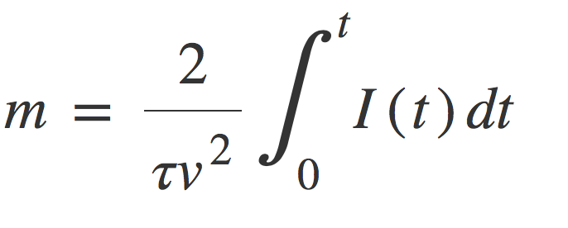
Results - Mass of Meteors
Data from 6688 meteors detected from 1/3/19 to 3/24/19.
Statistically significant difference at a level of ~99.6% significance between durations of two populations.
Used durations to determine average mass from two populations.
m - Mass of meteor
τ - Meteor luminous efficiency = .90
v - Geocentric velocity (km/s)
t - Duration of meteor (s)
I(t) - Instantaneous luminous intensity
Source: Friichtenicht, Joseph Fred, JCj Slattery, and E. Tagliaferri. "A laboratory measurement of meteor luminous efficiency." (1967).

Slide 10
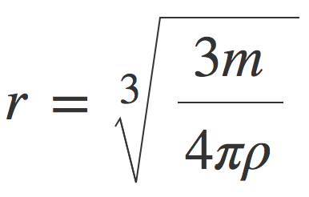

Results - Radius of Meteors
Can then convert mass to radius by the following relations:
m - Mass of meteor
ρ - Density
V - Volume of a sphere
r - Radius of meteor
Assumed density for shower population = 1 g/cm³
Assumed density for sporadic population = 3 g/cm³

Slide 11
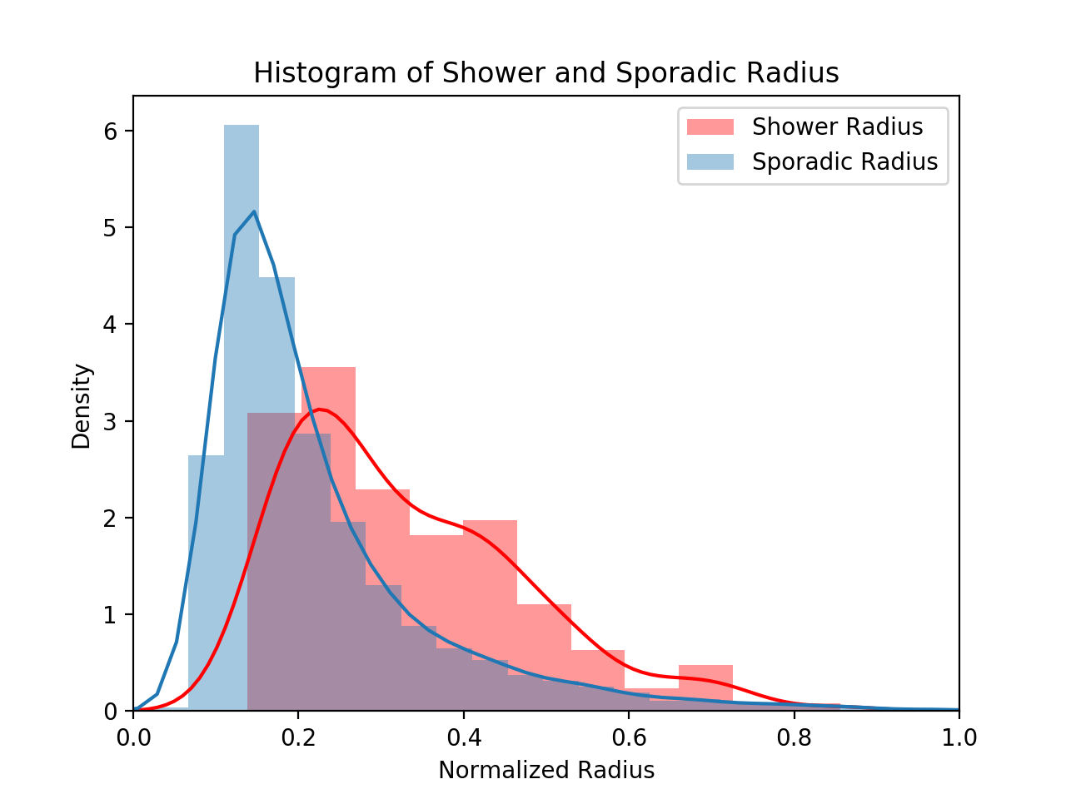
Results/Conclusions
Shower meteors are ~1.5 times larger than Sporadic meteors!
Conclusions:
The histogram shows that shower meteors are larger than sporadic meteors when entering the atmosphere.
Cause may be from formation processes or the survivability of the two populations in space.

Slide 12
Future Work
Look further into cause of difference between the radius of the two populations.
Use data from archives and analyze trends from years of meteor detections.
Create a taxonomy for characterization of light curve trends and behavior.
Explore more relations between light curve metrics and meteor population.

Slide 13




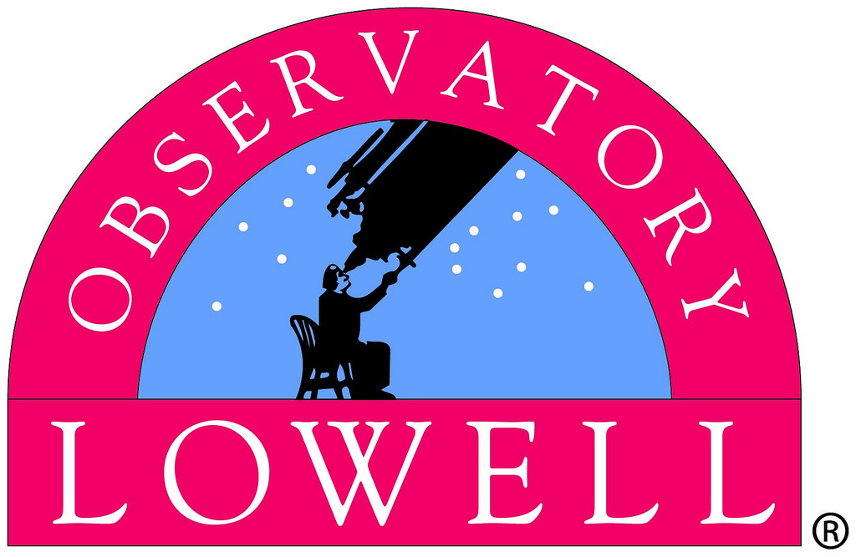
Acknowledgements
Dr. Nick Moskovitz, Lowell Observatory
Dr. Peter Jenniskens, SETI Institute
Dave Samuels
Robert Schottland
Dr. Nadine Barlow, Northern Arizona University
Kathleen Stigmon, Northern Arizona University
Lowell Observatory Marcus Cometary Research Fund

